Slide 1
Introduction to C
UNCLASSIFIED

Slide 2
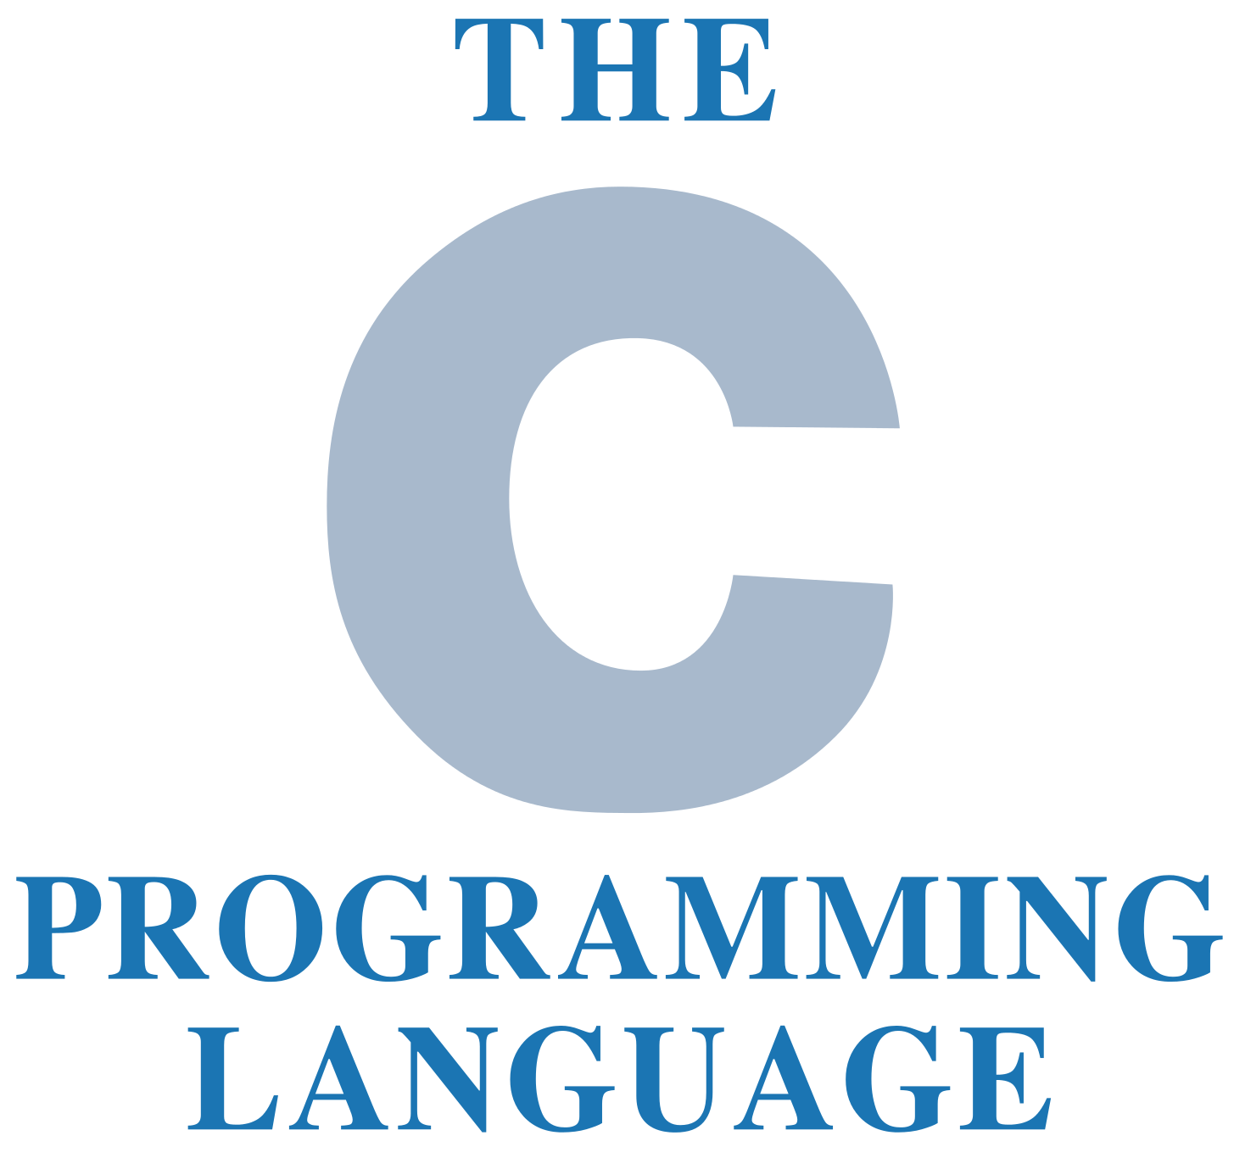
Outline
Definitions
Language Features
C Specifics

Slide 3
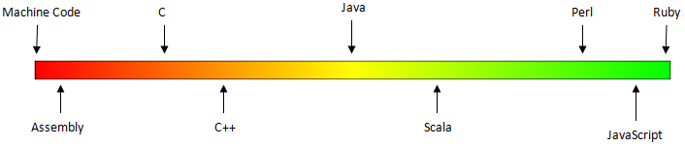
Definitions
Language Level
Low-level
Provides little to no abstraction from hardware
Concentrates on what’s going on in the machine hardware
Direct memory management
High-level
Strong abstraction from hardware
Easier to understand, comparatively
Concentrates on the program
Notes:
Middle-level – vague; mixed low/high attributes

Slide 4
Definitions
Statement
Bits of code that do things
Human readable text a compiler will turn into executable statements
Block – A group of executable statements
Function – A block of code written to perform a single specific task
Whitespace
Tabs, spaces and newline/End of Line (EOL) characters that separate text characters in source code
Any character or series of whitespace characters that represent horizontal or vertical space
Notes:
Whitespace - any character or series of whitespace characters that represent horizontal or vertical space in typography. When rendered, a whitespace character does not correspond to a visible mark, but typically does occupy an area on a page.
Whitespace Examples:
' ' (0x20) space (SPC)
'\t' (0x09) horizontal tab (TAB)
'\n' (0x0a) newline (LF)
'\v' (0x0b) vertical tab (VT)
'\f' (0x0c) feed (FF)
'\r' (0x0d) carriage return (CR)

Slide 5
Definitions
Scope – The level at which a piece of data or function is visible
Integrated Development Environment (IDE)
Software application that provides facilities to computer programmers for software development
Normally consists of source code editor, build automations tool and a debugger
Pseudocode
Informal high-level description of an operating principle or a computer program or algorithm
Uses structural conventions of the intended language
Intended to be human readable, not machine code

Slide 6
C Language Features
Program Control Flow
Enter at top, exit at bottom
Single-entry/single-exit structure
Connect exit point of one control structure to entry point of next (control-structure stacking)
Makes programs easy to build
Free Format – several statements can share a single line
printf(“Integer?\n”); scanf(“%d”, &i); i = i / 10;
printf(“Integer?\n”);
scanf(“%d”, &i);
i = i / 10;

Slide 7
C Language Features
Functions
main() is customarily the first function
Any function referenced by main() must be declared or listed before main()
main() is only required in a hosted environment (such as an operating system)
Types
Enforces data types
Declarations/definitions eliminate ambiguities
Two types of data:
Built-In
Derived
Notes:
Data Types:
Basic/Built-In
Integer (int)
Floating-point (float)
Double precision (double)
Character (char)
Derived
Arrays
Character strings
structures

Slide 8
C Language Features
Two types of data:
Built-In
Integer (int) – positive or negative integer
Floating-point (float) – single precision decimal number
Double precision (double) – double float precision
Character (char) – stores a single character
Derived
Arrays – a collection of values, all of the same type, stored contiguously in memory
Character strings – an array of characters (char)
Structures – a grouped list of variables referenced by one name and one memory pointer
Notes:
Data Types:
Basic/Built-In
Integer (int) - basic signed integer type. At least in the [−32767,+32767] range, thus at least 16 bits in size.
Floating-point (float) - single precision floating-point type. Actual properties unspecified (except minimum limits), however on most systems this is the IEEE 754 single-precision binary floating-point format. This format is required by the optional Annex F "IEC 60559 floating-point arithmetic".
Double precision (double) - double precision floating-point type. Actual properties unspecified (except minimum limits), however on most systems this is the IEEE 754 double-precision binary floating-point format. This format is required by the optional Annex F "IEC 60559 floating-point arithmetic".
Character (char) - smallest addressable unit of the machine that can contain basic character set. It is an integer type. Actual type can be either signed or unsigned depending on the implementation.
Derived
Arrays
For every type T, except void and function types, there exist the types “array of N elements of type T”.
An array is a collection of values, all of the same type, stored contiguously in memory. An array of size N is indexed by integers from 0 up to and including N-1.
Character strings
Structures
Structures are a way of storing multiple pieces of data in one variable. For example, say we wanted to store the name and birthday of a person in strings, in one variable. We could use a structure to house that data:
struct birthday { char name[20]; int day; int month; int year; };

Slide 9
C Language Features
IDE
Eclipse – Cross-platform
Microsoft Visual Studio Express – Windows
Borland C++ – Windows
Turbo C – oldest IDE for C; Windows
GNU Compiler Collection (GCC) – Cross-platform
C Whitespace
Mostly benefits humans, not the machine
Tabs, spaces, and carriage returns typically used to organize code blocks
Semi-colon (;) is used as End-Of-Line (EOL) marker
To compile and run C code in Ubuntu using GCC:
Step 1: gcc –o <output file> <input file>
Step 2: chmod a+x <output file>
Step 3: ./<output file>
Example…
Step 1: gcc –o evilscript evilscript.c
Step 2: chmod a+x evilscript
Step 3: ./evilscript
Notes:
The steps to compile and execute C code in Ubuntu is included here in case the instructor wishes to lead the students through some amplifying hands-on exercises. The steps listed are described here:
Step 1: The syntax for gcc includes a switch (-o) to name your output file. Spaces are necessary between the command elements… gcc^-o^output file^input file
Step 2: The chmod command modifies file mode bits. To execute the compiled code, the “execute” bit must be turned on. In the command syntax, “a” modifies the bit for everyone (owner, group, and everyone else), the plus symbol (+) turns on a bit. “x” represents the bit that will be modified. In the case of Step 2, “x” happens to be the “execute” bit. The last element of the command is the file to be modified. To explain the syntax of example in Step 2 using plain-speak, the chmod command will be turning on the execute bit for the “evilscript” file’s owner, group and anyone who cares to execute it.
Step 3: Attempting to run the code without “./” in front of “evilscript” is likely not to work. Ubuntu, like most operating systems, has a list of default paths to look for binaries when an executable command is issued. Chances are, the student did not compile the evilscript executable into one of those paths. To be safe, execute the command preceded by a period and forward slash (./). The period indicates “this directory” and the forward slash indicates “a file or directory within this directory”.

Slide 10
C Specifics
Powerful Features
Pointers
Pointer variables
Dynamic Storage
Blocks/functions book-ended with {}
int main()
{
printf(“Hello world”); //Prints to screen
return 0; //Ends main()
}

Slide 11
C Specifics
Filenames
Header files (.h)
Object files (.o)
Source code (.c)
Uses header files to define C functions to be shared between several source files
System headers - define interfaces to the operating system
Personal headers

Slide 12
C Specifics
Comments
// Single line comment
/* Multi-line comment */
#include <stdio.h>
/************************
*** Written for P-IQT ***
************************/
int main()
{
printf(“Hello world”); //Prints to screen
return 0; //Ends main()
}

Slide 13
Summary
Definitions
Language Features
C Specifics
Unclassified

